Slide 1
4-1 INTRODUCTION
At the conceptual level, we can think of the global Internet as a black box network that connects millions (if not billions) of computers in the world together. At this level, we are only concerned that a message from the application layer in one computer reaches the application layer in another computer.
TCP/IP Protocol Suite

Slide 2
Topics Discussed in the Section
General Introduction
TCP/IP Protocol Suite

Slide 3
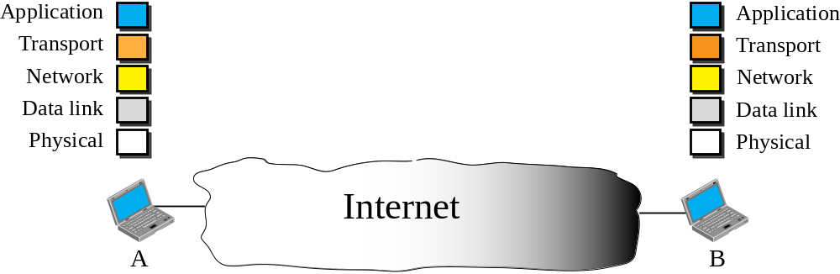
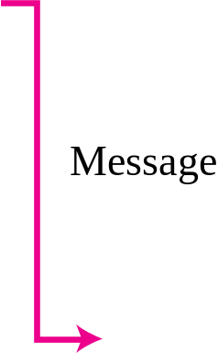
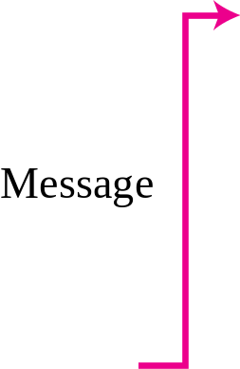
Figure 4.1 Internet as a block box
TCP/IP Protocol Suite

Slide 4
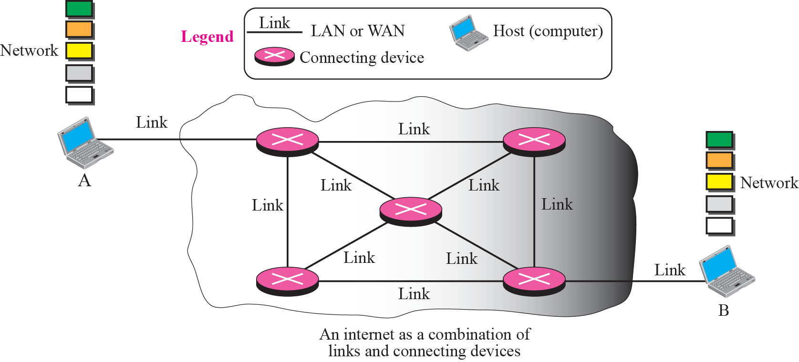
Figure 4.2 Internet as a combination of LANs and WANs connected together
TCP/IP Protocol Suite

Slide 5
4-2 SWITCHING
From the previous discussion, it is clear that the passage of a message from a source to a destination involves many decisions. When a message reaches a connecting device, a decision needs to be made to select one of the output ports through which the packet needs to be send out. In other words, the connecting device acts as a switch that connects one port to another port.
TCP/IP Protocol Suite

Slide 6
Topics Discussed in the Section
Circuit Switching
Packet Switching
TCP/IP Protocol Suite

Slide 7

Note
In circuit switching, the whole message is sent from the source to the destination without being
divided into packets.
TCP/IP Protocol Suite

Slide 8
Example 4.1
A good example of a circuit-switched network is the early telephone systems in which the path was established between a caller and a callee when the telephone number of the callee was dialed by the caller. When the callee responded to the call, the circuit was established. The voice message could now flow between the two parties, in both directions, while all of the connecting devices maintained the circuit. When the caller or callee hung up, the circuit was disconnected. The telephone network is not totally a circuit-switched network today.
TCP/IP Protocol Suite

Slide 9
Note
In packet switching, the message is first divided into manageable packets at the source before being transmitted.
The packets are assembled at the destination.
TCP/IP Protocol Suite

Slide 10
4-3 PACKET SWITHING
The network layer is designed as a packet-switched network. This means that the packet at the source is divided into manageable packets, normally called datagrams. Individual datagrams are then transferred from the source to the destination. The received datagrams are assembled at the destination before recreating the original message. The packet-switched network layer of the Internet was originally designed as a connectionless service, but recently there is a tendency to change this
to a connection-oriented service.
TCP/IP Protocol Suite

Slide 11
Topics Discussed in the Section
Connectionless Service
Connection-Oriented Service
TCP/IP Protocol Suite

Slide 12
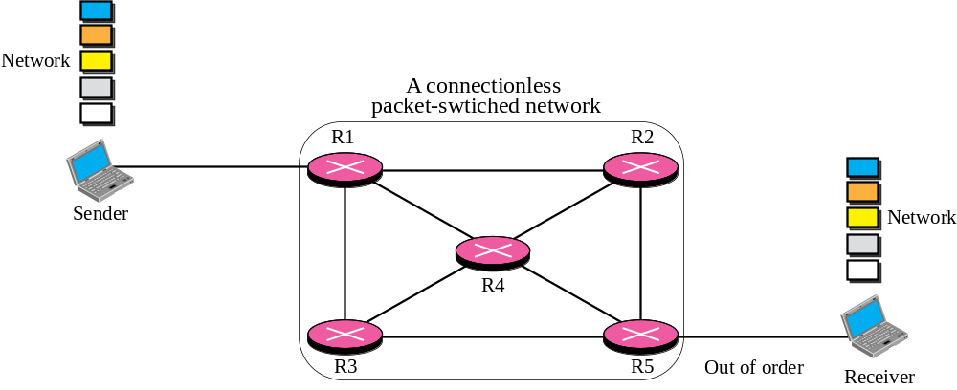







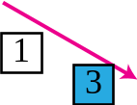



Figure 4.3 A connectionless packet-switched network
TCP/IP Protocol Suite

Slide 13
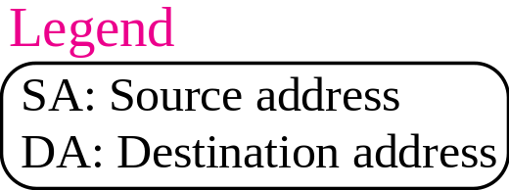
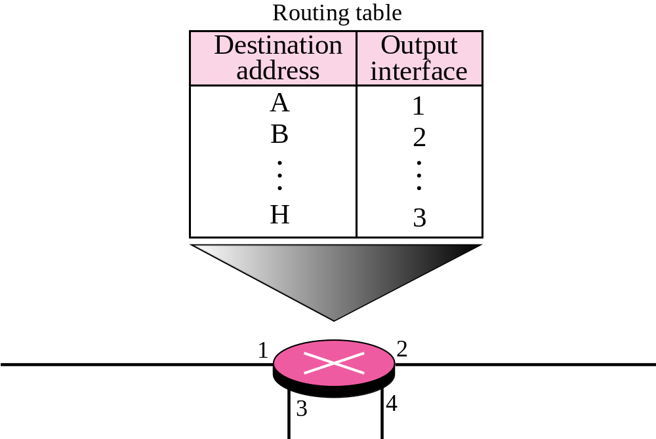
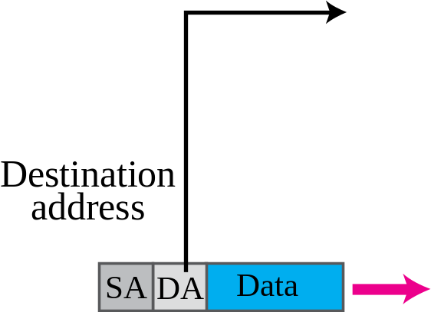
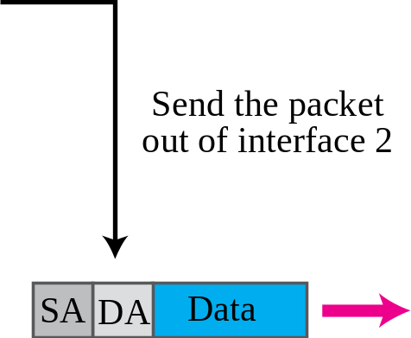
Figure 4.4 Forwarding process in a connectionless network
TCP/IP Protocol Suite

Slide 14
Note
In a connectionless packet-switched network, the forwarding decision
is based on the destination address of the packet.
TCP/IP Protocol Suite

Slide 15
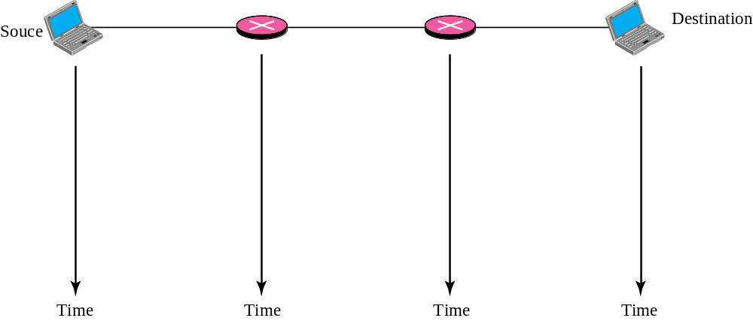






Figure 4.5 Delay in a connectionless network
TCP/IP Protocol Suite
Notes:
Waiting
time

Slide 16
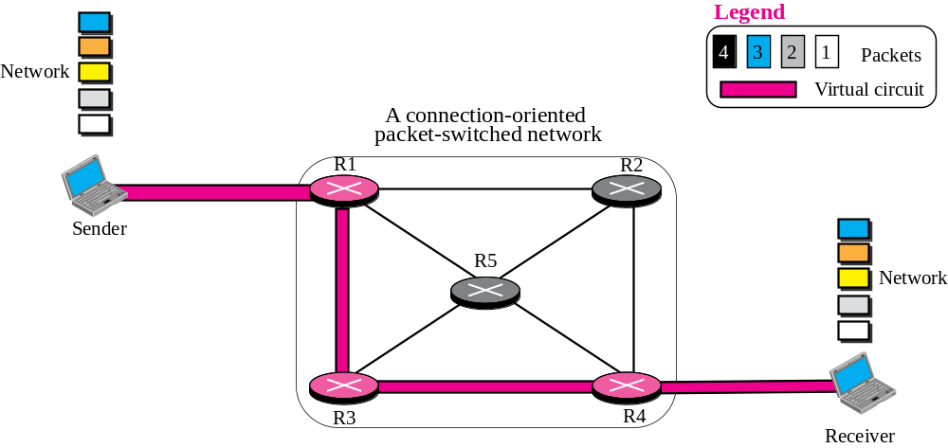
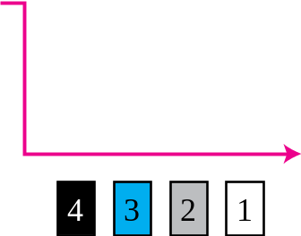




Figure 4.6 A connection-oriented packet switched network
TCP/IP Protocol Suite

Slide 17
Note
In a connection-oriented packet switched network, the forwarding decision is based on the
label of the packet.
TCP/IP Protocol Suite

Slide 18
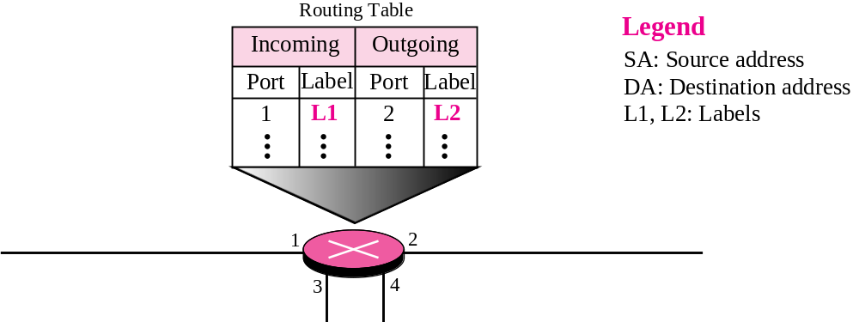
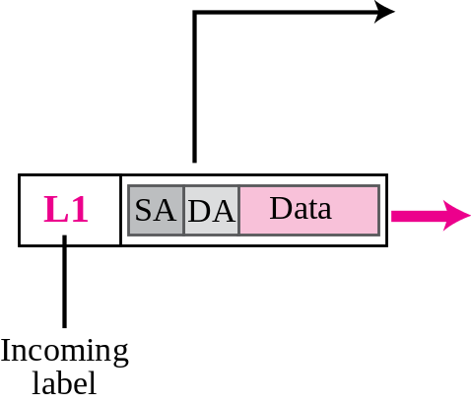
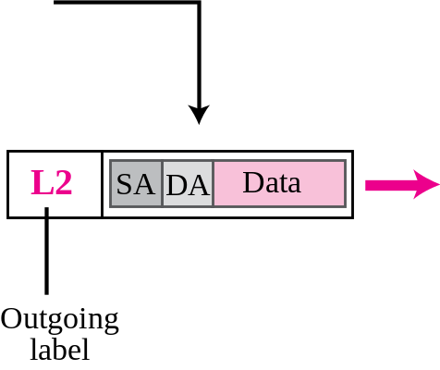
Figure 4.7 Forwarding process in a connection-oriented network
TCP/IP Protocol Suite

Slide 19
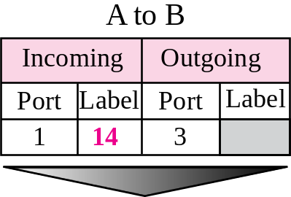
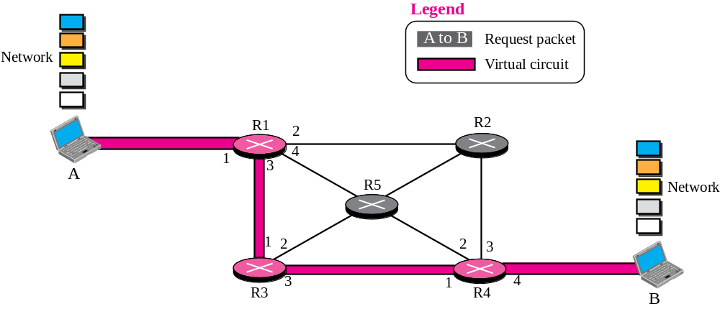
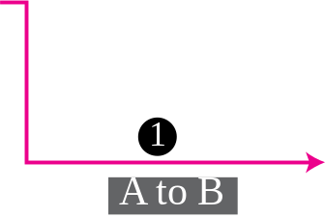
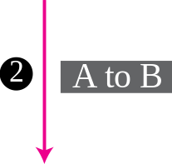
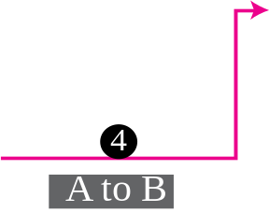
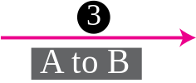
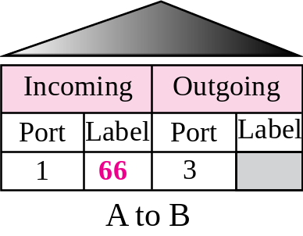

Figure 4.8 Sending request packet in a virtual-circuit network
TCP/IP Protocol Suite

Slide 20
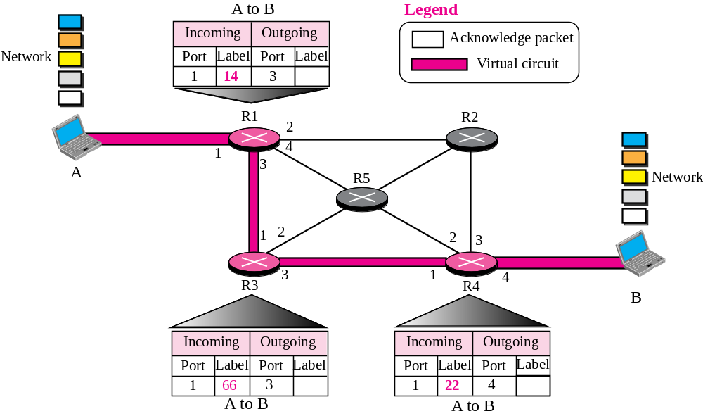
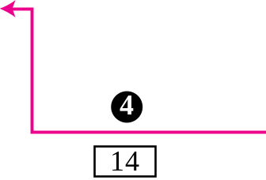
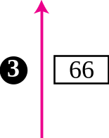
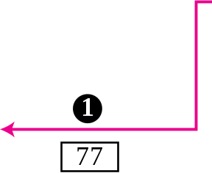

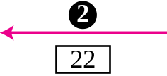


Figure 4.9 Setup acknowledgement in a virtual-circuit network
TCP/IP Protocol Suite

Slide 21
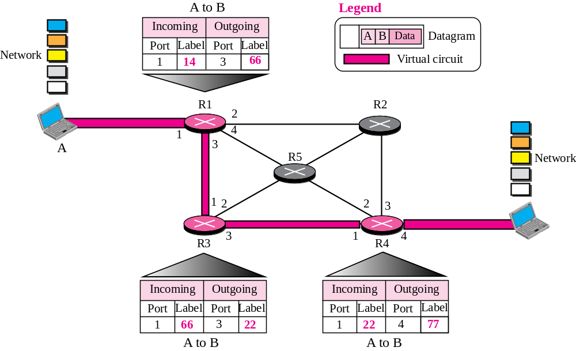
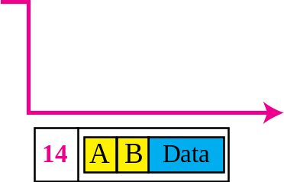
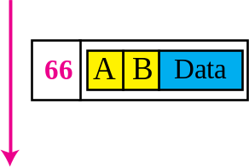
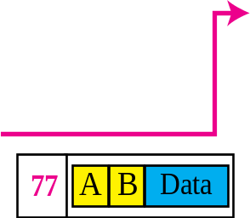
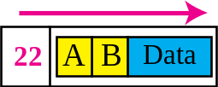
Figure 4.10 Flow of one packet in an established virtual circuit
TCP/IP Protocol Suite
Notes:
14ABData

Slide 22
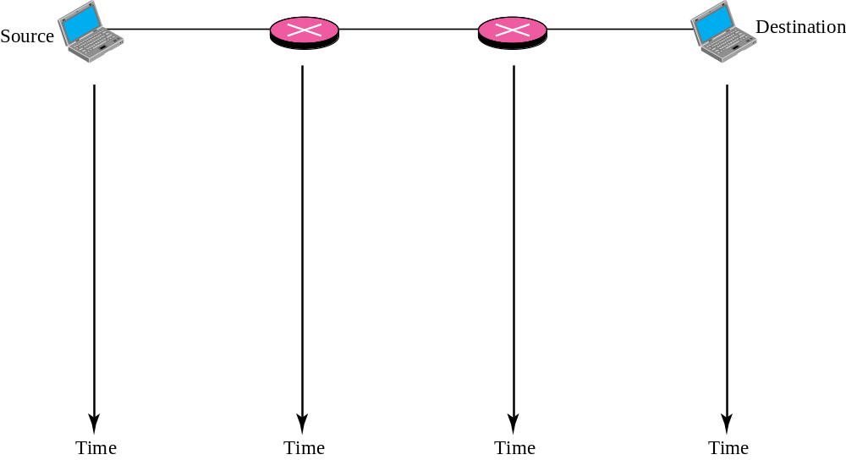


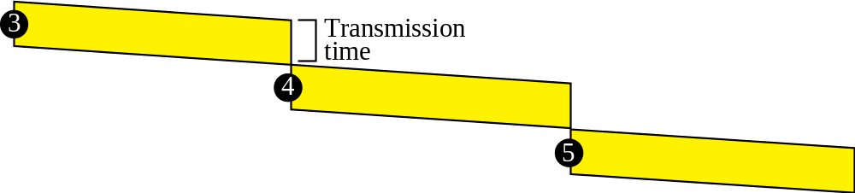

Figure 4.11 Delay in a connection-oriented network
TCP/IP Protocol Suite

Slide 23
4-4 NETWORK LAYER SERVICES
In this section, we briefly discuss services provided by the network layer. Our discussion is mostly based on the connectionless service, the dominant service in today’s Internet.
TCP/IP Protocol Suite

Slide 24
Topics Discussed in the Section
Logical Addressing
Services Provided at the Source Computer
Services Provides at the Each Router
Services Provided at the Destination Computer
TCP/IP Protocol Suite

Slide 25
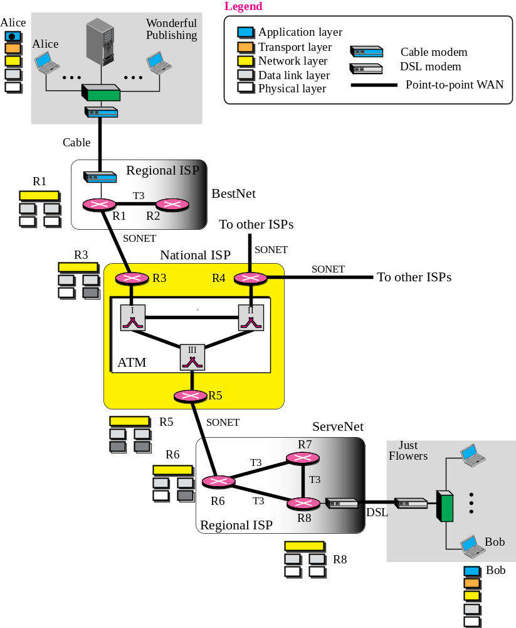
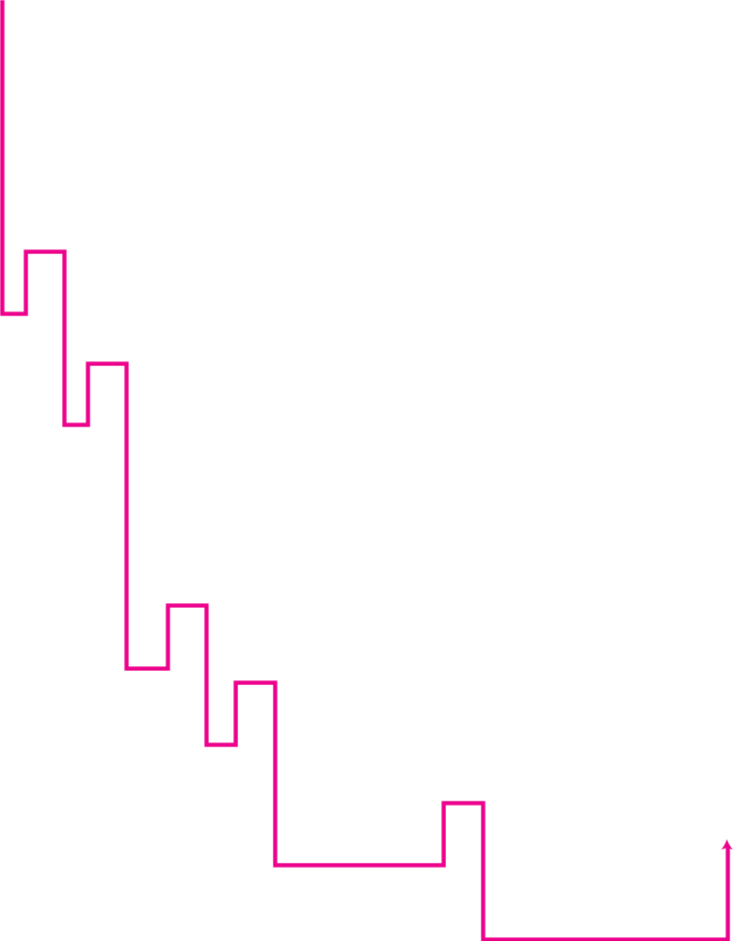
Figure 4.12 An imaginary part of the Internet
TCP/IP Protocol Suite

Slide 26
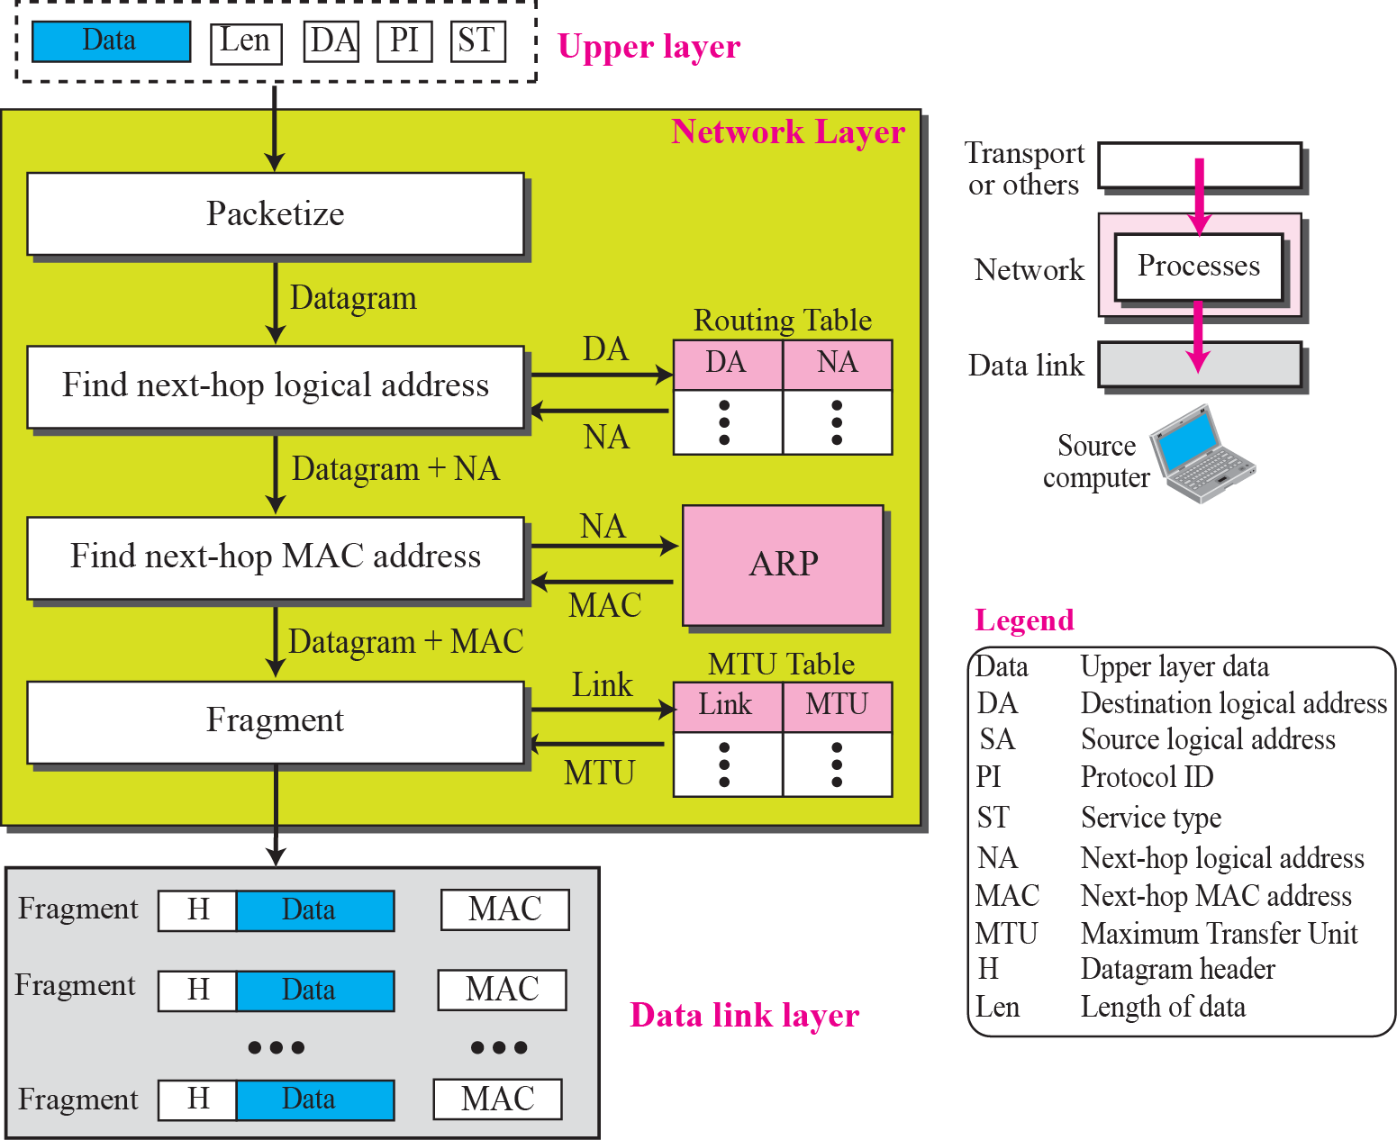
Figure 4.13 Services provided at the source computer
TCP/IP Protocol Suite

Slide 27
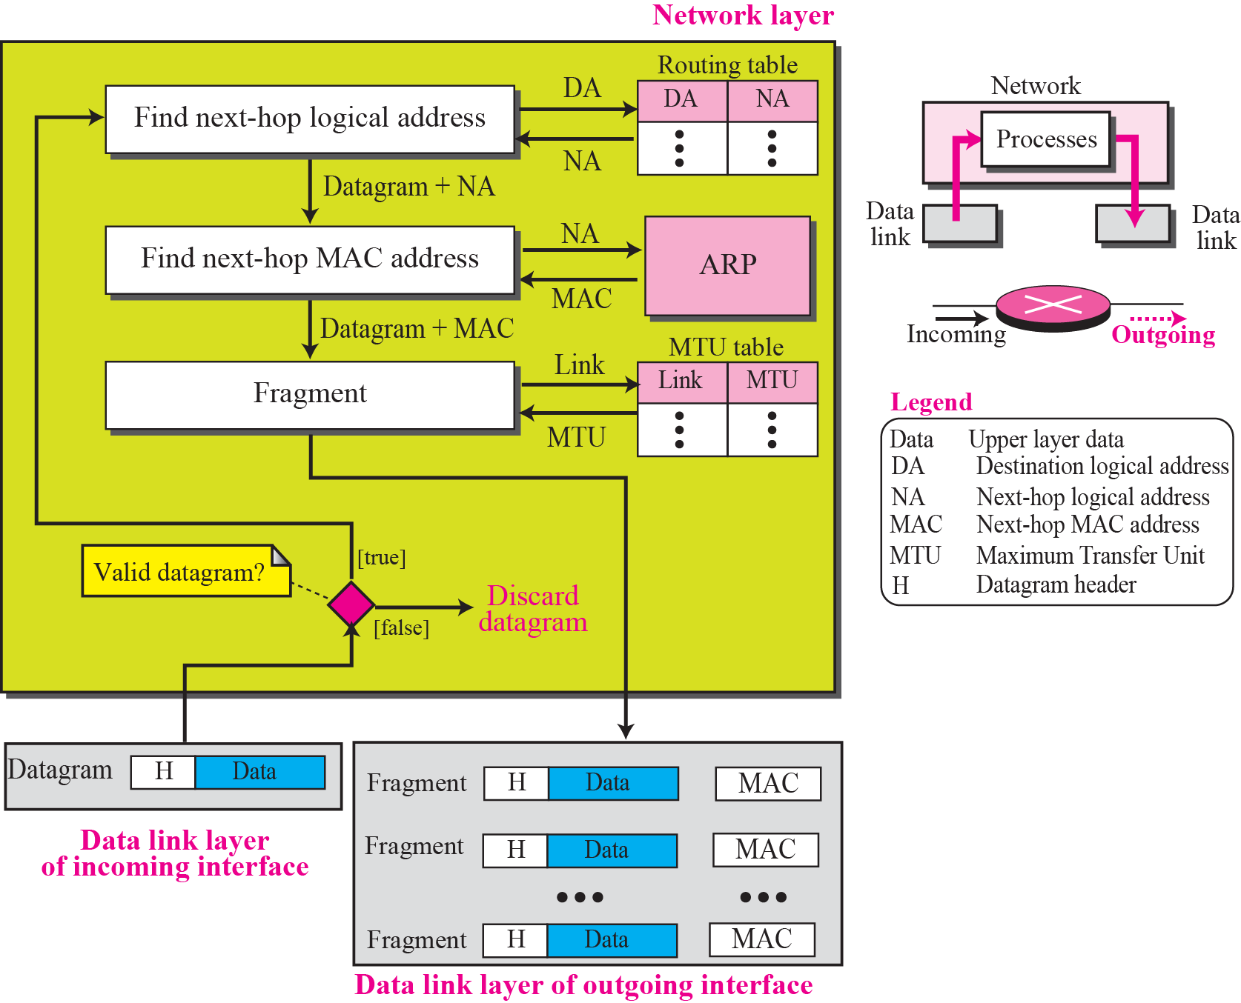
Figure 4.14 Processing at each router
TCP/IP Protocol Suite

Slide 28
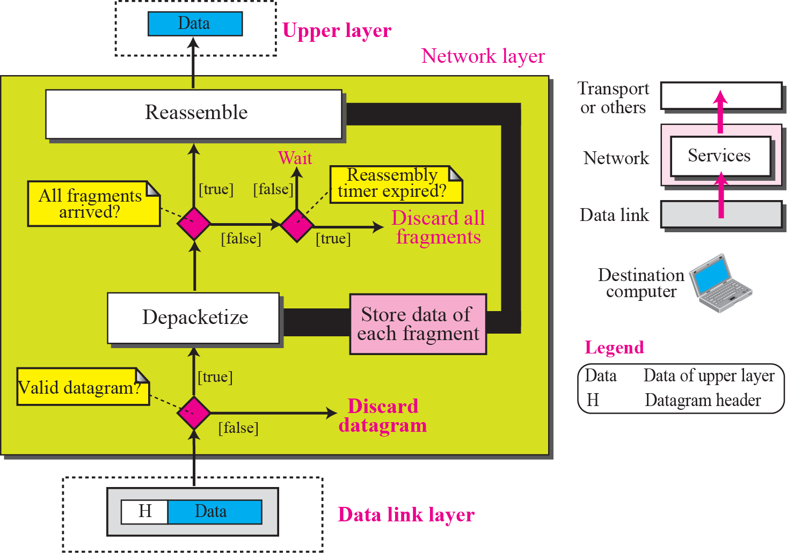
Figure 4.15 Processing at the destination computer
TCP/IP Protocol Suite

Slide 29
4-5 OTHER SERVICES
In this section we introduce some issues related to the network layer. These issues actually represent services that are normally discussed for the network layer, but they are either partially implemented at the network layer or not implemented at all. Some services are provided by some auxiliary protocols or by protocols added to the Internet later. Most of these issues resurface in future chapters.
TCP/IP Protocol Suite

Slide 30
Topics Discussed in the Section
Error Control
Flow Control
Congestion Control
Routing
Security
TCP/IP Protocol Suite

Slide 31
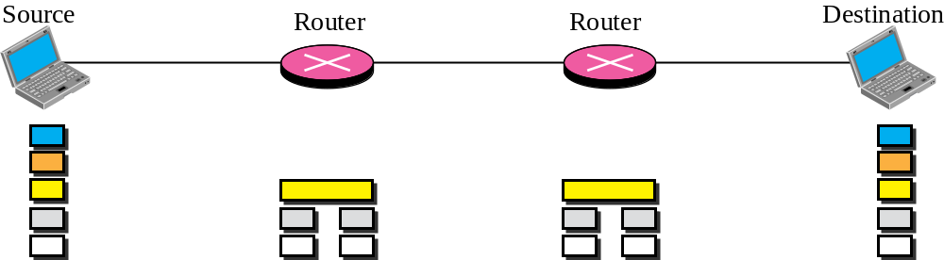

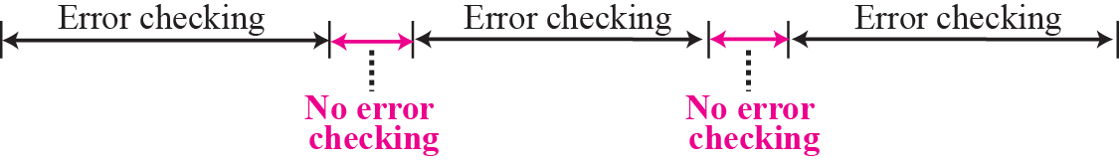
Figure 4.16 Error checking at the data link layer
TCP/IP Protocol Suite

Slide 32
Note
No flow control is provided for the current version of Internet network layer.
TCP/IP Protocol Suite

